Slide 1
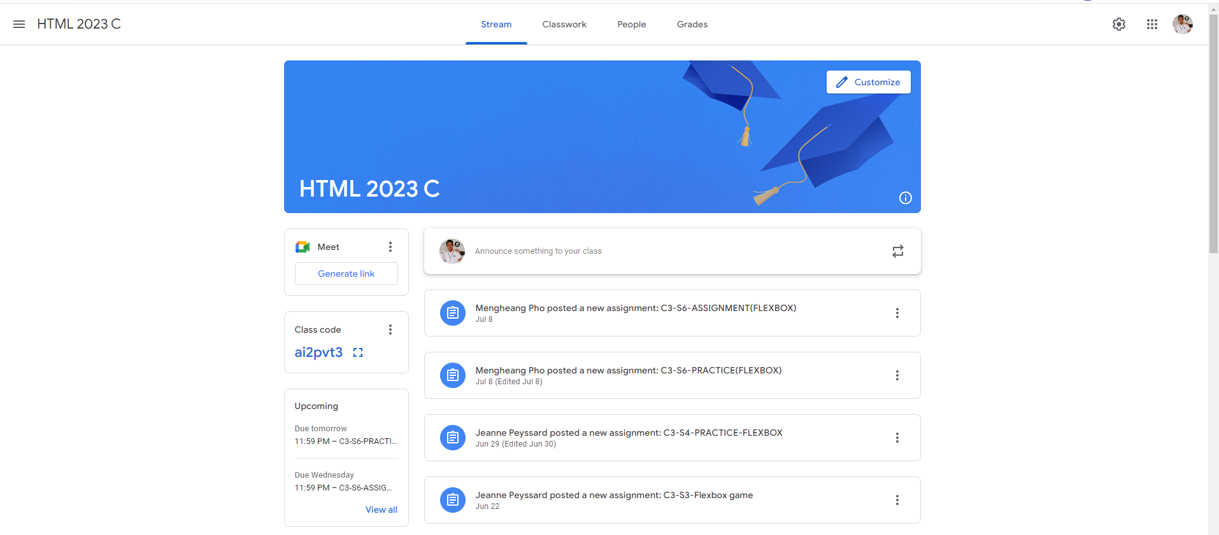
Identify root components of website below

Slide 2
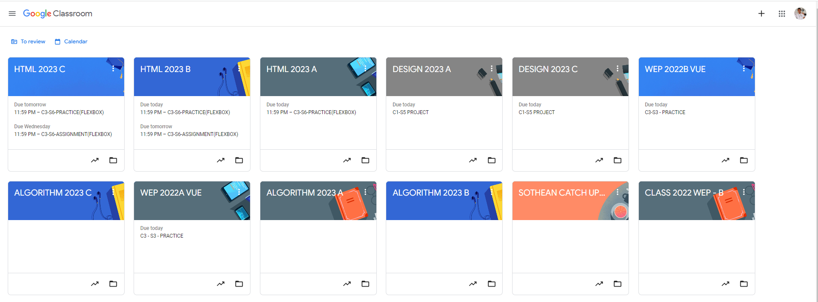
Root div
- Height: 100vh
content
nav
Flex: 0
header
Flex: 0
Flex: 1

Slide 3
Identify main elements
Flex 0: nav bar
Flex 1: content-container
flex-direction: column

Slide 4
Identify sub elements in nav bar
Flex 1
Flex 2
Flex 1
nav-left (Title Area)
nav-center
nav-right (Profile)
flex-direction: row

Slide 5
Identify sub elements in content-container
Flex 0: banner
Flex 1: contents
flex-direction: column

Slide 6
The contents is divided into 2 parts
flex 0
flex 1
content-sidebar
main-content
flex-direction: row

Slide 7
The content-sidebar is divided into 3 parts
Flex 0: Top-Section
(Meeting Link)
Flex 0: Middle-Section
(Class Code)
Flex 1: Bottom Section
(Assignments Information)
flex-direction: column

Slide 8
The main-content-container is divided into 2 parts
Flex 0: content-toolbar
Flex 1: content-stream
flex-direction: column

Slide 9
The content-toolbar can be divided into 2 sections
flex 1
flex 0
announcement-area
tool-area
flex-direction: row

Slide 10
Finally, in the content-stream we divide deeper into each content post
flex 0
flex 1
flex 0
logo
announcement-content
Content-tools
flex-direction: row

